Slide 1
Database Management Systems (DBMS)
Lec 27: Transaction Processing, Concurrency Control,
and Recovery (Contd.)
Ramesh K. Jallu
IIIT Raichur Date: 22/06/21

Slide 2
Recap
Variants of the two-phase locking protocol
Conservative 2PL scheme
Strict 2PL scheme
Rigorous 2PL scheme
Timestamp based protocols
Basic timestamp ordering protocol
Strict timestamp ordering protocol
Thomas's write rule
Notes:
2

Slide 3
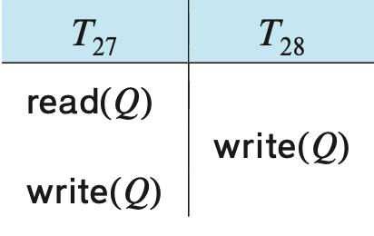
Thomas’s Write Rule (Recap)
It is a modified TOP, which allows greater potential concurrency than TOP
When T₂₇ attempts its write(Q) operation, we find that TS(T₂₇) < write_TS(Q), since write_TS(Q) = TS(T₂₈). Thus, the write(Q) by T₂₇ is rejected and transaction T₂₇ must be rolled back
Although the rollback of T₂₇ is required by the timestamp-ordering protocol, it is unnecessary
Since T₂₈ has already written Q, the value that T₂₇ is attempting to write is one that will never need to be read
Notes:
3

Slide 4
Thomas’s Write Rule (Contd.) (Recap)
Any transaction T_{i} with TS(T_{i}) < TS(T₂₈) that attempts a read(Q) will be rolled back, since TS(T_{i}) < write_TS(Q)
Any transaction T_{j} with TS(T_{j}) > TS(T₂₈) must read the value of Q written by T₂₈, rather than the value that T₂₇ is attempting to write
Thomas's write rule
If read_TS(X) > TS(T), then abort and roll back T and reject the operation.
If write_TS(X) > TS(T), then do not execute the write operation but continue processing
If neither the condition in 1 nor the condition in 2 occurs, then execute the write_item(X) operation of T and set write_TS(X) to TS(T)
Notes:
4

Slide 5
View serializable
Thomas's write rule doesn't enforce conflict serializability, but enforces another form of equivalence called view serializability
There may be some schedules that are not conflict-serializable but still gives a consistent result
What if a schedule’s precedence graph contains a cycle and is giving consistent result as a conflict serializable schedule is giving?
The problem of testing for view serializability has been shown to be NP-hard and, hence, rarely used
Notes:
5

Slide 6
View equivalent
Two schedules S and S′ are said to be view equivalent if the following conditions hold
S and S' contain the same set of transactions and the same operations of those transactions
Initial read: If T_{i} is the first transaction in S to read the data item X, then T_{i} is the first transaction in S' to read X
Updated read: If T_{i} reads an item X that has written by another transaction T_{j} in S, then the same condition must hold for the value of X read by operation of T_{i} in S′
Final write: If T_{k} is the last operation to write item Y in S, then of T_{k} must also be the last operation to write item Y in S′
Notes:
6

Slide 7
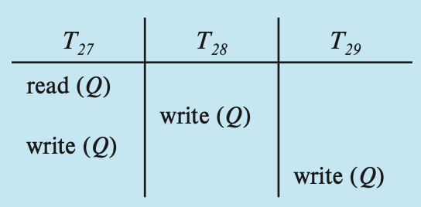
Example
A schedule S is said to be view serializable if it is view equivalent to a serial schedule
Every conflict-serializable schedule is also view serializable, but converse not necessarily be true
A blind write is a write operation in a transaction T on an item X that is not dependent on the old value of X, so it is not preceded by a read of X in the transaction T
View equivalent to <T₂₇,T₂₈,T₂₉>
Notes:
7

Slide 8
Multiversion Concurrency Control Techniques
The CC techniques discussed thus far ensure serialzability either by delaying the operation or aborting the transacion
For example, a read_item(X) operation may be delayed because the appropriate value has not been written yet; or it may be rejected because the value that it was supposed to read has already been overwritten
These difficulties could be avoided if old copies of each data item were kept in a system
Notes:
8

Slide 9
Multiversion Concurrency Control Techniques (Cont.)
Each write_item(X) operation of a transaction creates a new version of X and retains the old versions of X
When a transaction requests to read_item(X), the appropriate version of X is chosen to maintain the serializability of the currently executing schedule
It is very crucial that a transaction be able to determine easily and quickly which version of the data item should be read
Notes:
9

Slide 10
Multiversion Concurrency Control Techniques (Cont.)
The reason for keeping multiple versions is that instead of rejectingor delyaing a read_item(X) operation it can still be accepted by reading an older version of the item X if it maintains serializability
An obvious drawback of multiversion techniques is that more storage is needed to maintain multiple versions of the database items
We discusse two schemes
Multiversion Timestamp Ordering
Multiversion Two-Phase Locking
Notes:
10

Slide 11
Multiversion timestamp ordering
With each data item X, a sequence of versions <X₁, X₂, ... , X_{m}> is associated
Each version X_{k} contains three data fields:
Content is the value of version X_{k}
write_TS(X_{k} ) is the timestamp of the transaction that created version X_{k}
read_TS(X_{k} ) is the largest timestamp of any transaction that successfully read version X_{k}
Notes:
11

Slide 12
Ensuring serializability
If transaction T issues a read_item(X) operation, find the version i of X that has the highest write_TS(X_{i}) of all versions of X that is also less than or equal to TS(T)
Then return the value of X_{i} to transaction T, and set the value of read_TS(X_{i}) to the larger of TS(T) and the current read_TS(X_{i})
If transaction T issues a write_item(X) operation, and version i of X has the highest write_TS(X_{i}) of all versions of X that is also less than or equal to TS(T), and read_TS(X_{i}) > TS(T)
Then abort and roll back transaction T
Otherwise, create a new version X_{j} of X with read_TS(X_{j}) = write_TS(X_{j}) = TS(T)
Notes:
12

Slide 13
Observations
A read_item(X) is always successful
In typical database systems, where reading is a more frequent operation than is writing, this advantage may be of major practical significance
This multiversion timestamp-ordering scheme does not ensure recoverability and cascadelessness
It can be extended in the same manner as the basic timestamp- ordering scheme to make it recoverable and cascadeless
Notes:
13

Slide 14
Multiversion Two-Phase Locking
In this multiple-mode locking scheme, there are three locking modes for an item - read, write, and certify
Thus, there three lock states associated with each variable X
Unlike in standard locking scheme, this scheme allows other transactions T' to read an item X while a single transaction T holds a write lock on X
This is accomplished by allowing two versions for each item X
Notes:
14

Slide 15
Multiversion Two-Phase Locking (Cont.)
Commited version: The item X is written by a comitted transaction
Local vesion: This version, X', can be created when a transaction T acquires a write lock on X
Other transactions can continue to read the committed version of X while T holds the write lock
Transaction T can write the value of X′ as needed, without affecting the value of the committed version X
However, once T is ready to commit, it must obtain a certify lock on all items that it currently holds write locks on before it can commit
Notes:
15

Slide 16
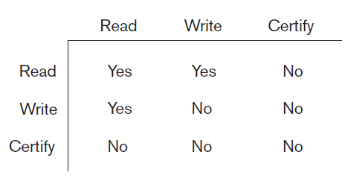
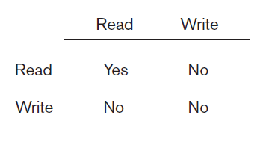
Lock compatability table
Notes:
16

Slide 17
Validation (Optimistic) Techniques
WKT a certain degree of checking is done before a database operation can be executed
Such checks are overhead and slow down the transactions execution
We need schemes that impose less overhead
How do we know which transactions will be involved in conflict?
Notes:
17

Slide 18
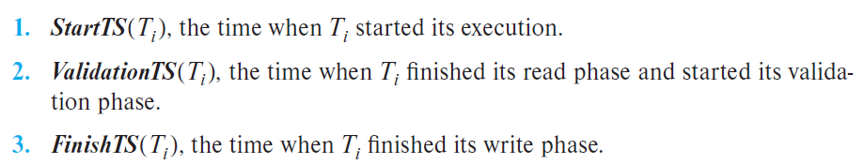
Validation (Optimistic) Techniques (Cont.)
Each transaction T_{i} executes in two or three different phases in its lifetime, depending on whether it is a read or a write transaction
Read phase
Validation phase
Write phase
Each transaction is associated with 3 timestamps
Notes:
18

Slide 19
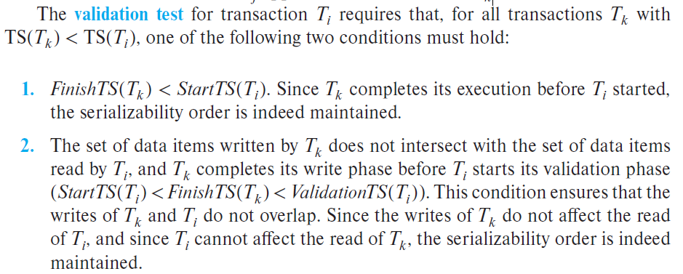
Testing for serializability
If the value TS(T_{i}) = ValidationTS(T_{i}) and, if TS(T_{j}) < TS(T_{k}), then any produced schedule must be equivalent to a serial schedule in which transaction T_{j} appears before transaction T_{k}
Notes:
19

Slide 20
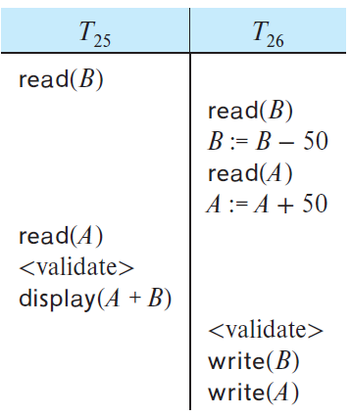
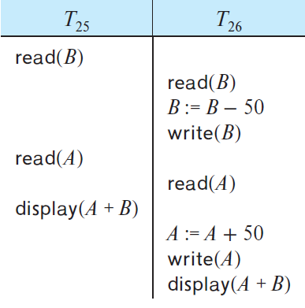
Example
Notes:
20

Slide 21
Thank you!

